Slide 1



MAGNUM WONDERPLAST PVT. LTD.
WE MOULD YOUR IDEAS

Slide 2













C O N T E N T
01
02
03
04
Company Overview
Product &
Technology
In-house Tool Design & Tool Making
Customers & Honors

Slide 3



01
Company Overview

Slide 4
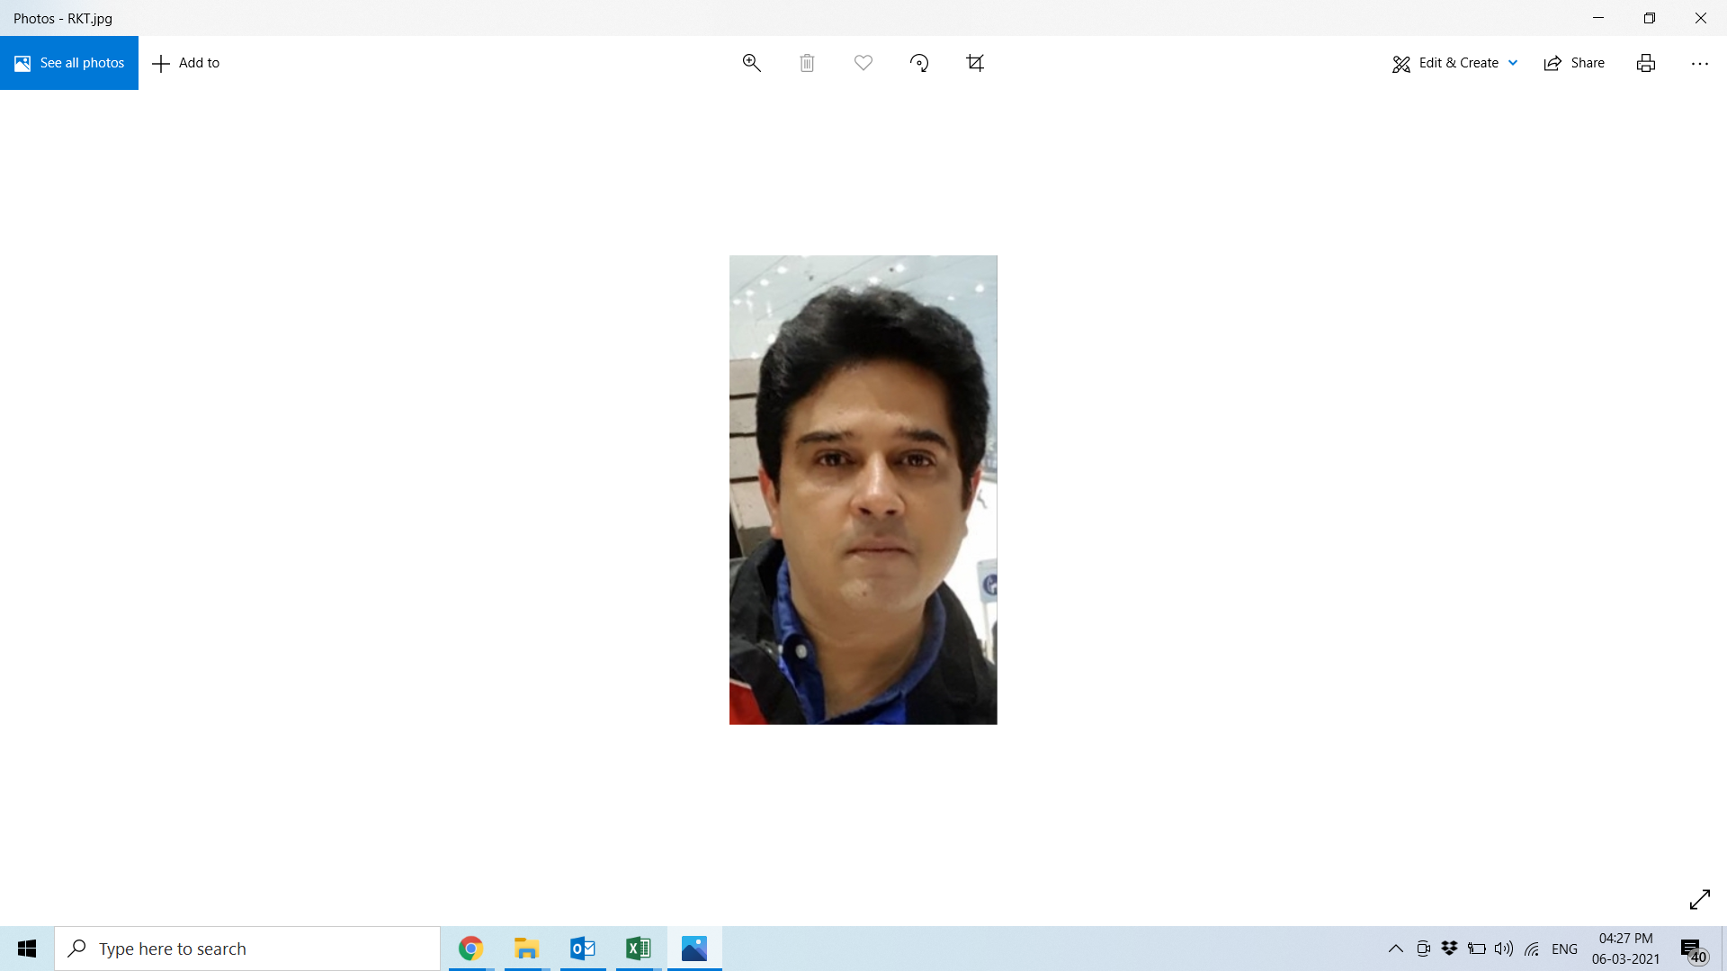


INTRODUCTION
ESTABLISHED
IN
1995
IATF – 16949
ISO – 14001
CERITIFIED
MR. RAJIV TREHAN
FOUNDER & MD
A QUAILIFIED PLASTICS TECHNOLOGIST HAVING 28 YEARS EXPERIENCE IN PLASTICS FIELD

Slide 5


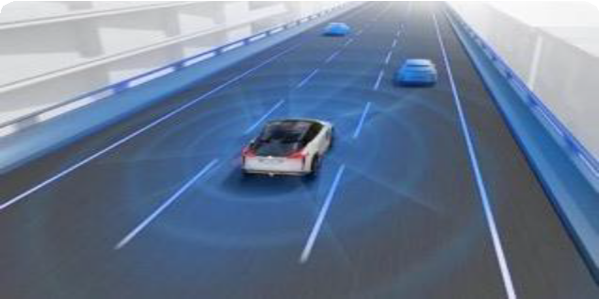











Vision
Mission
Goal
50
Goal: Top 50 Plastics Solution Provider
Vision: Excellence Through Innovative Solutions
Mission: Serving Customers Through Continuous Innovation
At Magnum Polymers our vision is to drive innovation and excellence through our precision engineering and creative solutions. We aim to revolutionize industries by providing top-tier, customized plastic molding solutions that cater to diverse needs and challenges.
To provide our customers with a full range of value-added products and services that exceed their expectations. To develop and retain dedicated, empowered employees who share in our success. To continuously improve & to achieve profitable growth over the long term using Innovative new manufacturing technologies to improve the performance and optimize the cost.
Reaching top 50 Plastics Solution Provider Nation Wide

Slide 6
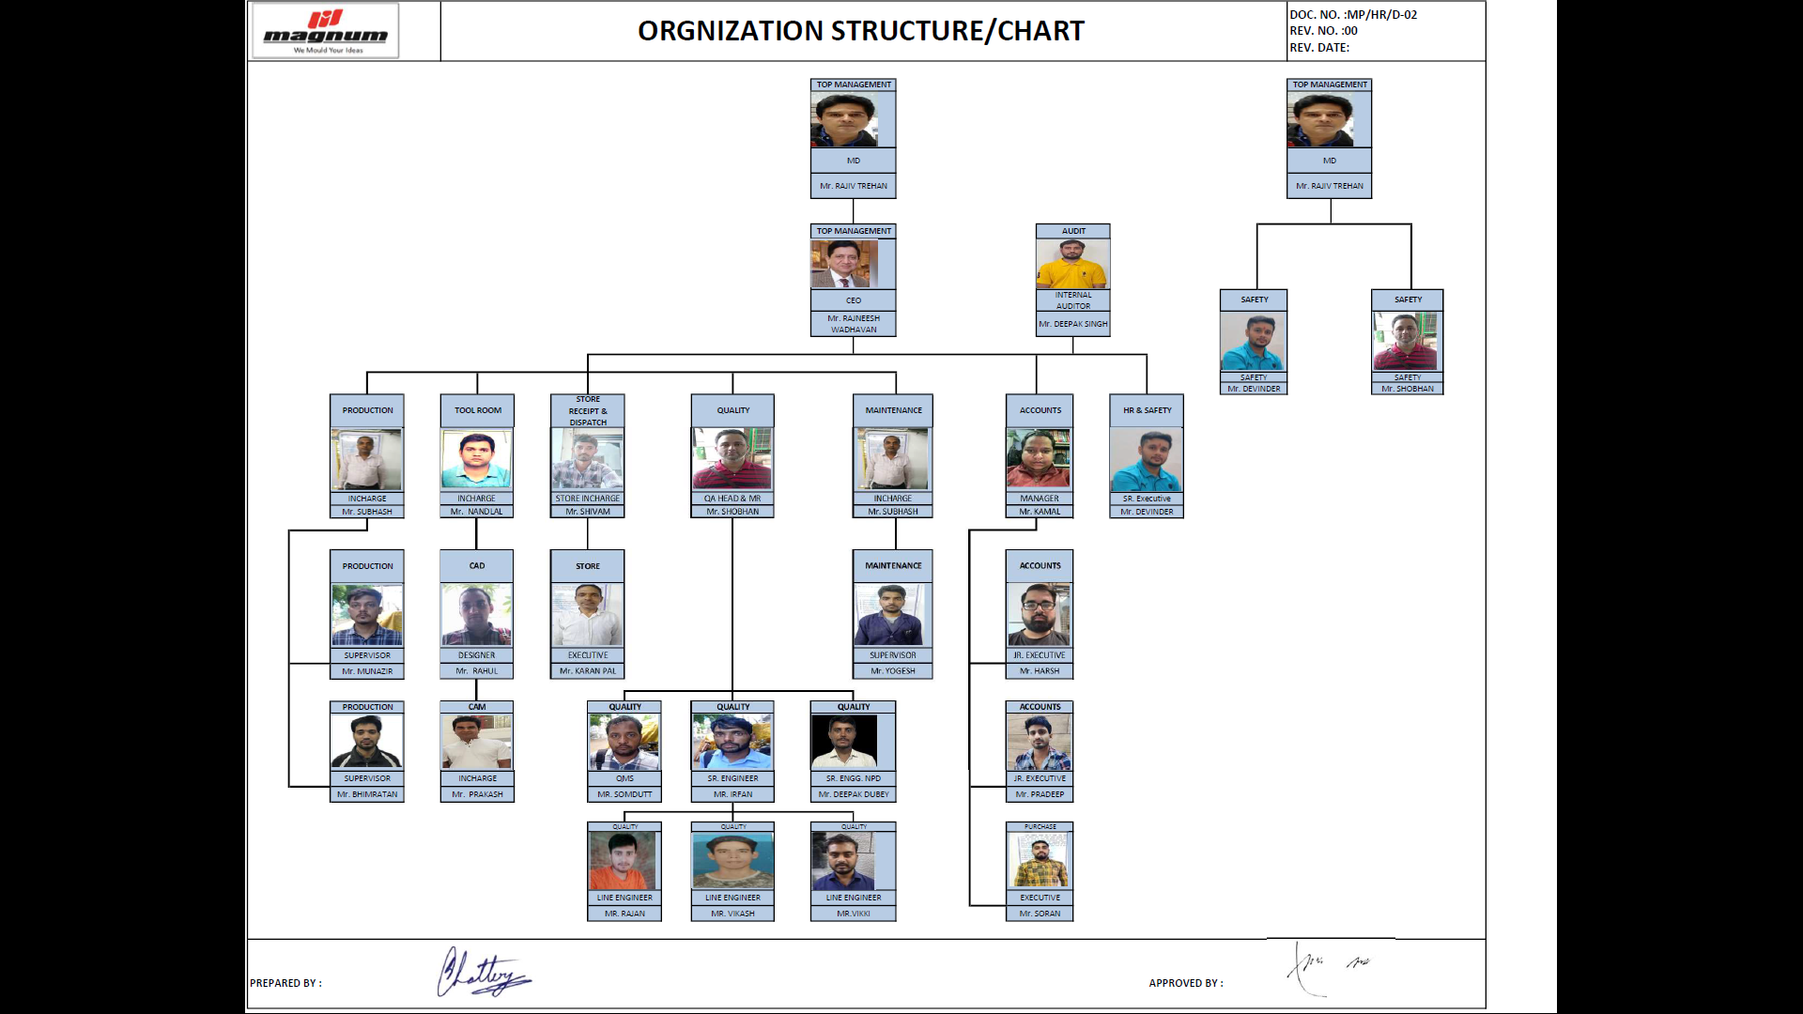
ORGANISATION STRUCTURE

Slide 7
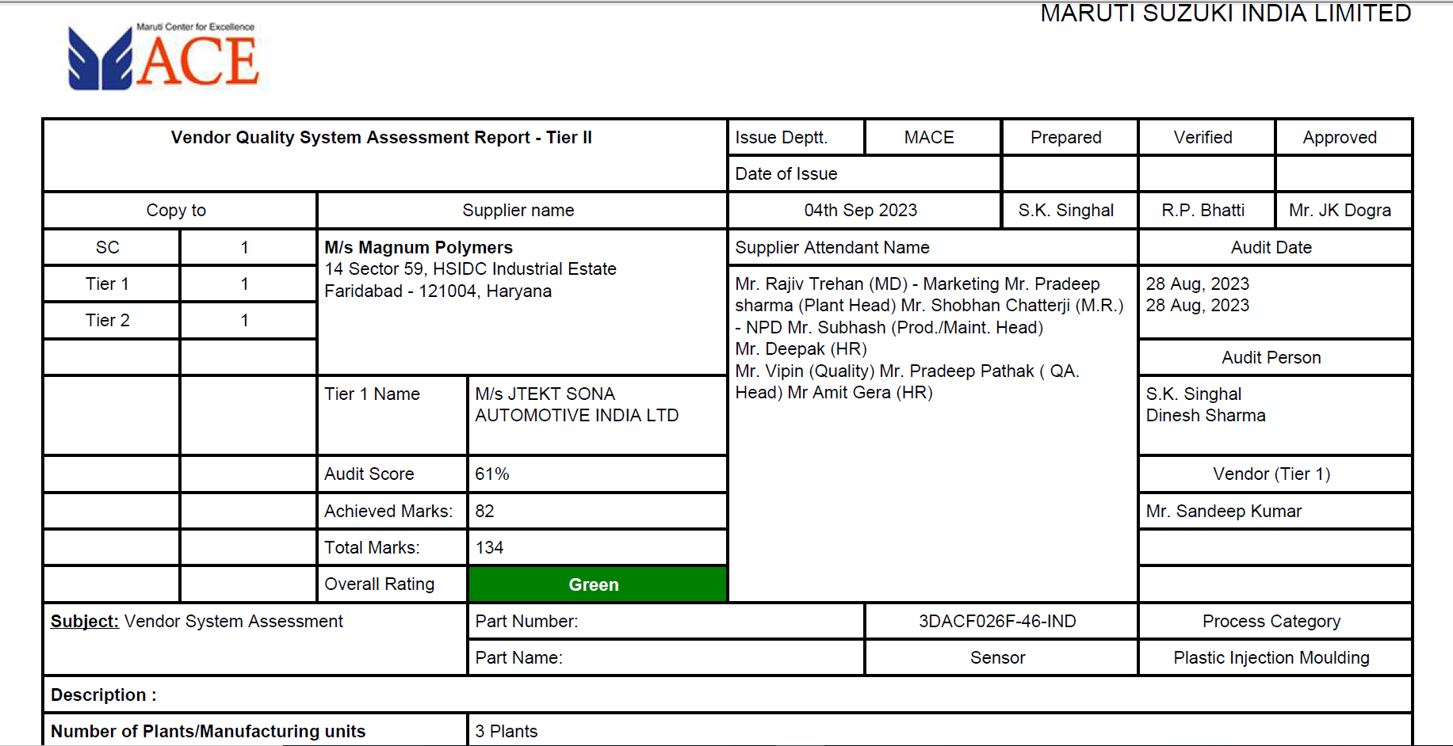
GREEN VENDOR BY MACE

Slide 8
02
Product Technology
INJECTION MOULDING
BLOW MOULDING
TOOLING

Slide 9
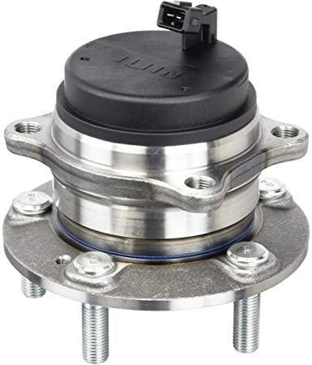
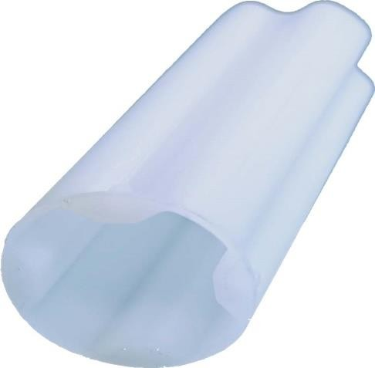
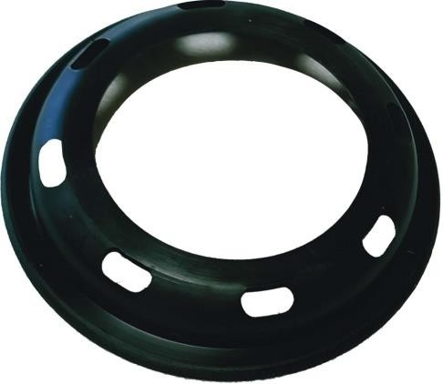
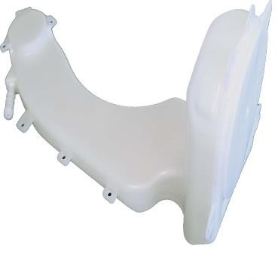
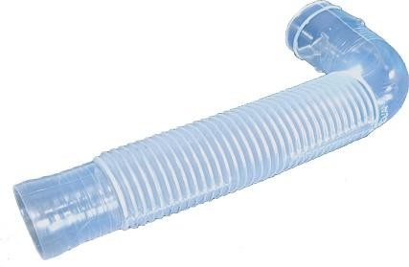
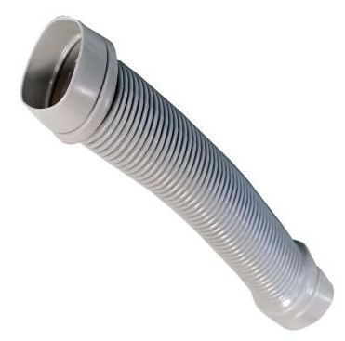
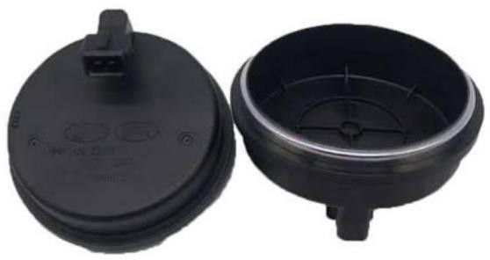
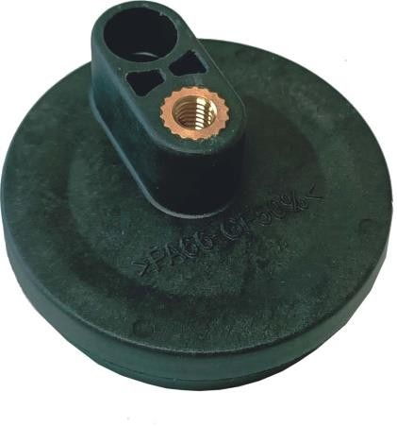
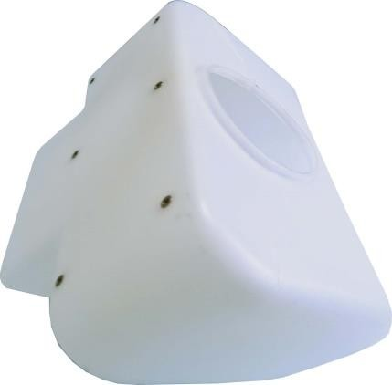
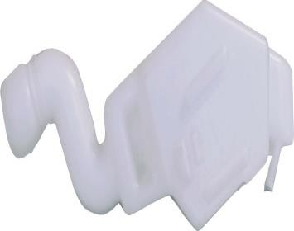
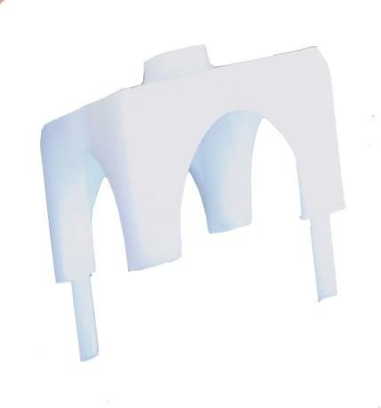
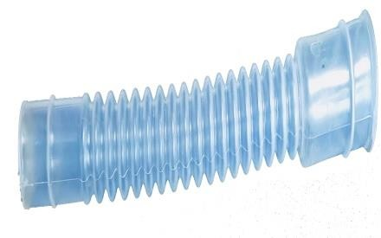
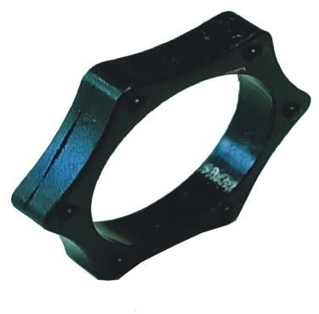
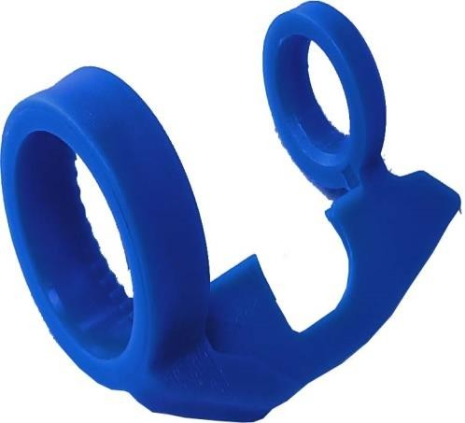
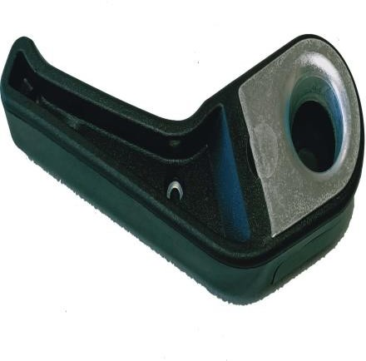
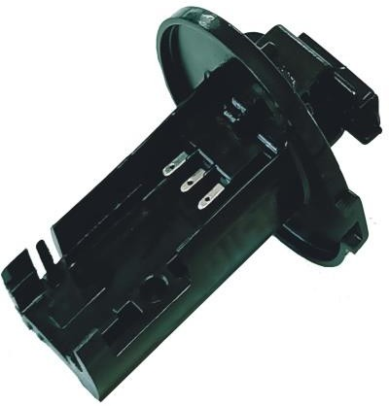
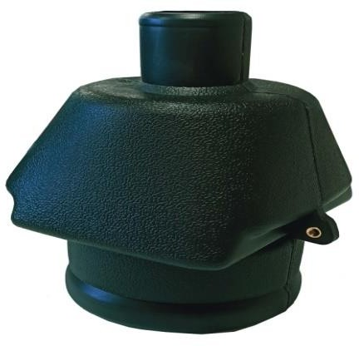
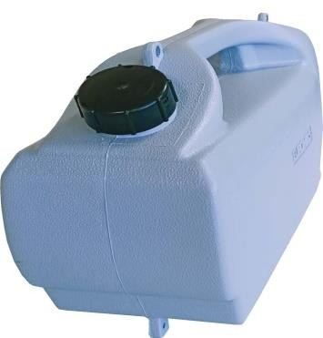
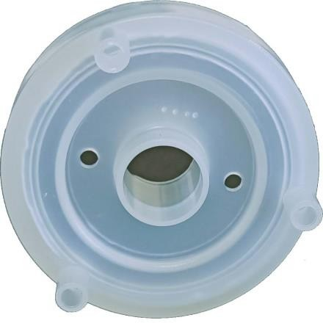
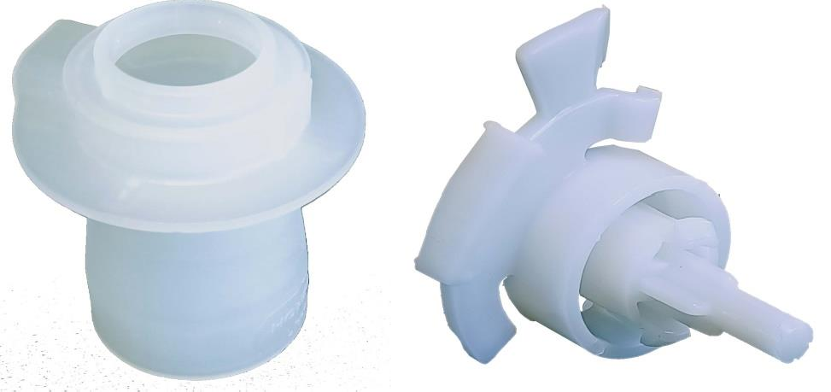
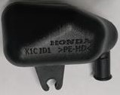
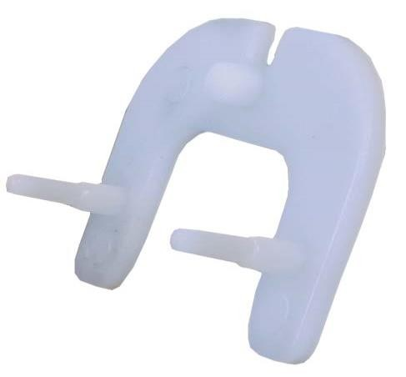
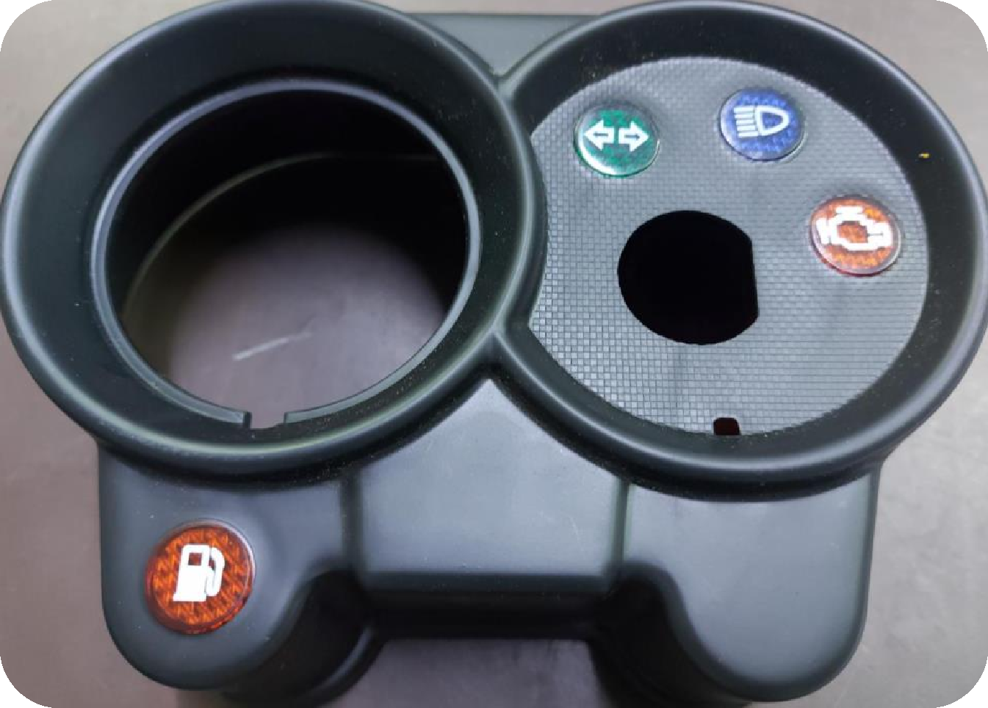
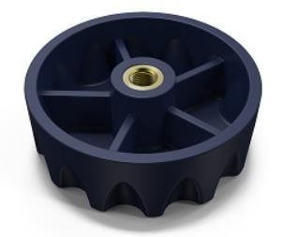
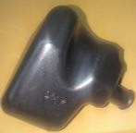
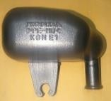
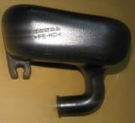
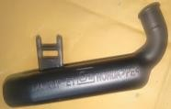
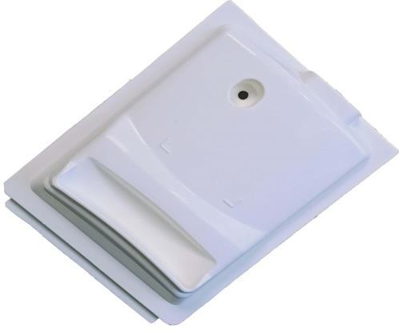
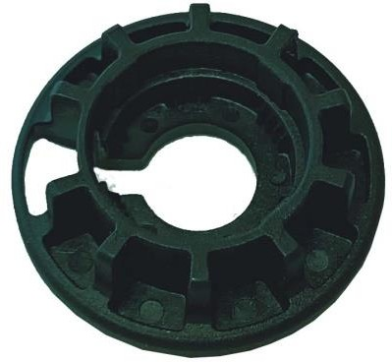
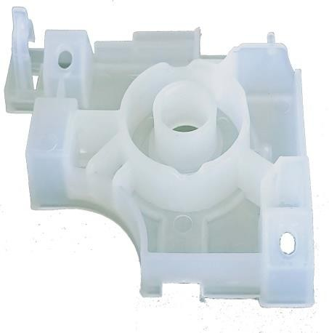
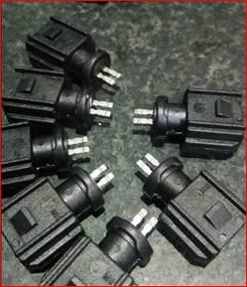
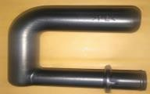
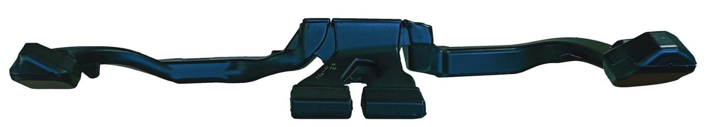
Core Products : AUTOMOTIVE
INJECTION MOULDING
BLOW MOULDING
INSERT MOULDING
Protector Oil Seal
Spacer Tilt
Plastic Sleeve
Half Protector Cap
CAP Strg Gear Center Marking
Cover Steering Gear
Basket Drain
Drain Lever Cap
Washer dryer refresher condenser
Hose
Hose Overflow
PP Tank
Tank Assembly
Resonator
Duct
Sensor Cover
Sensor Holder
Lever Assembly
Protective Cap
Body Kopa
Wiring Harness Connector
TVS Housing Speedometer

Slide 10

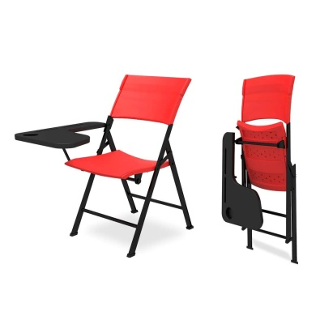
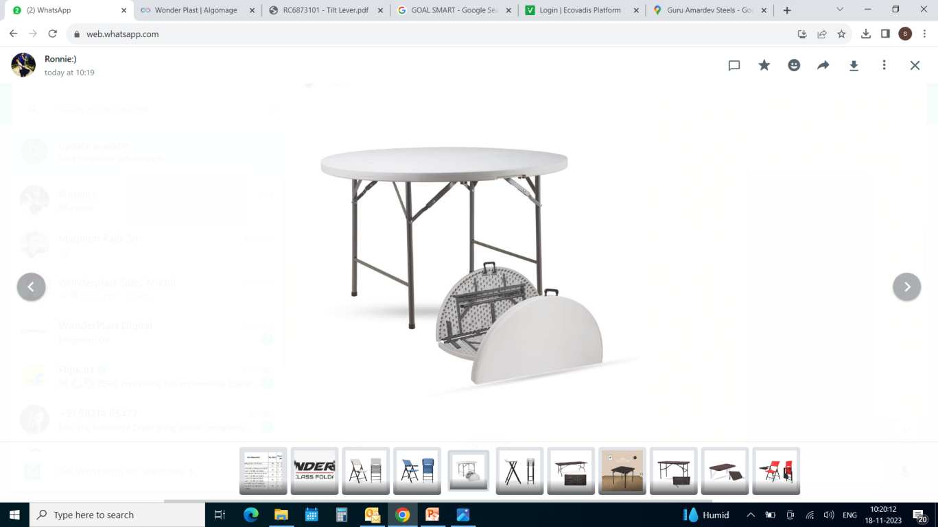
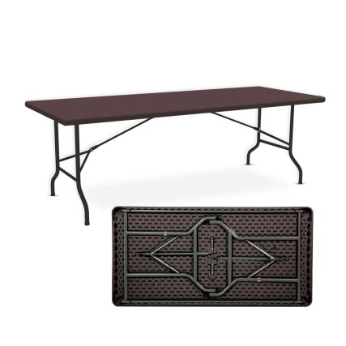
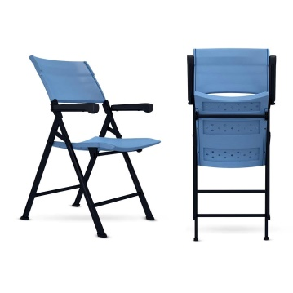
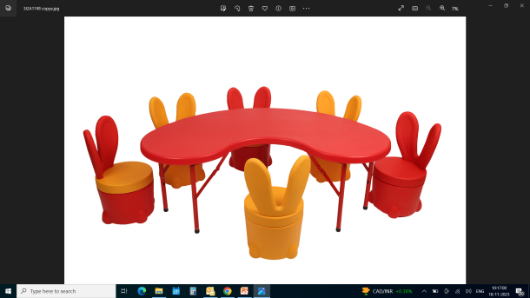
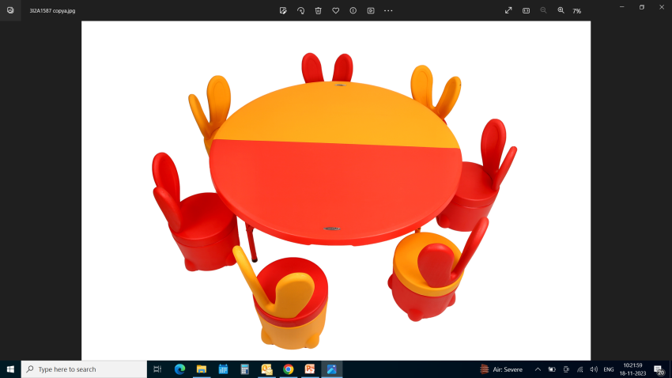
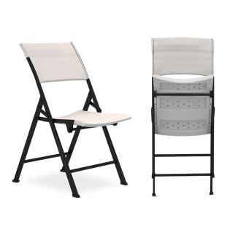
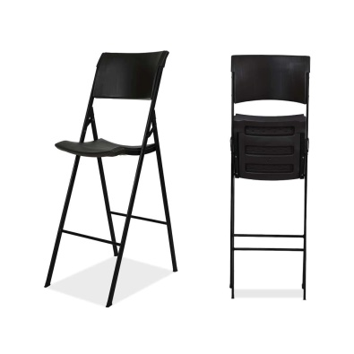
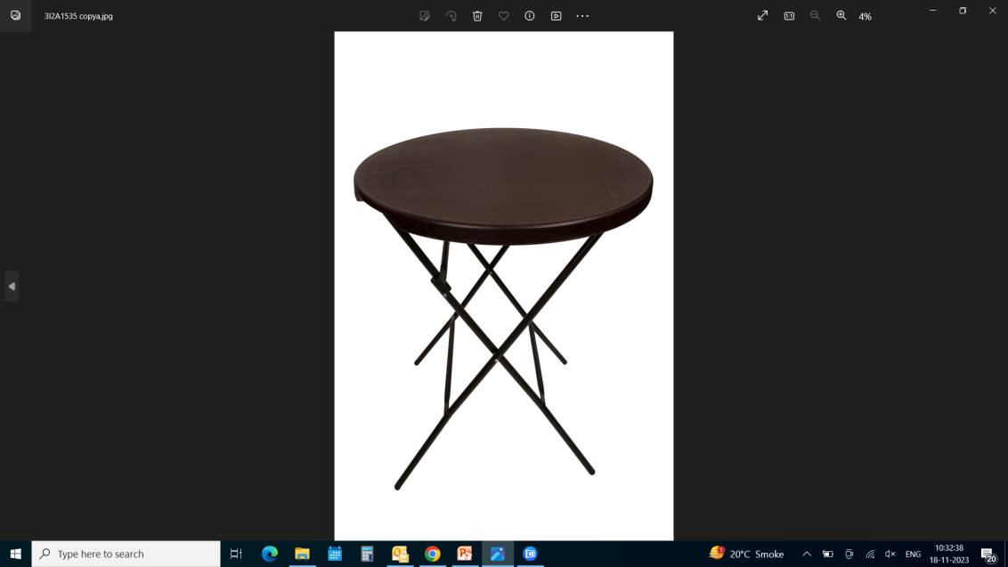
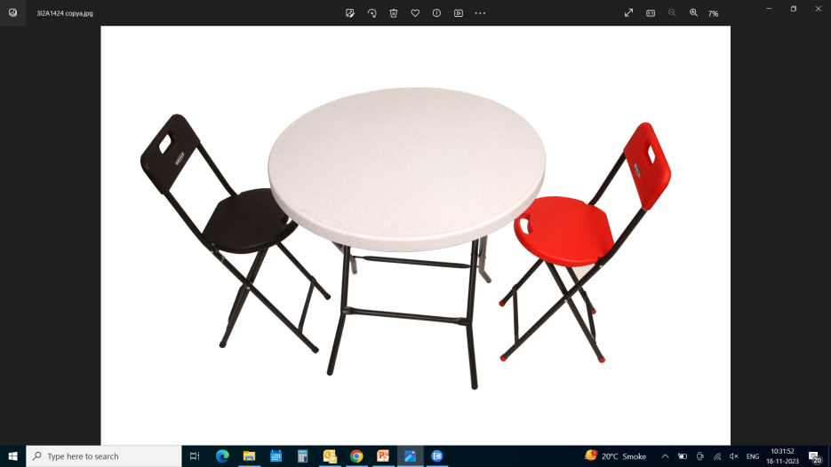
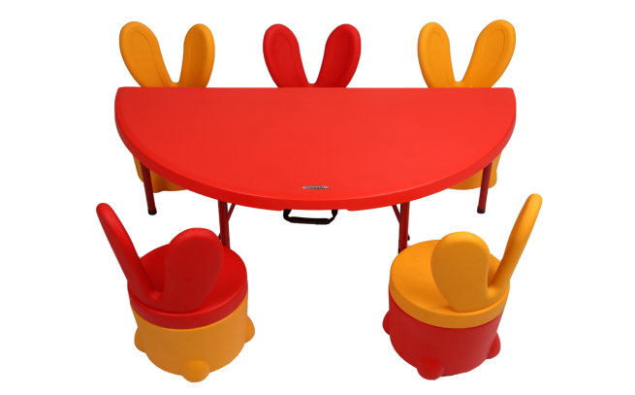
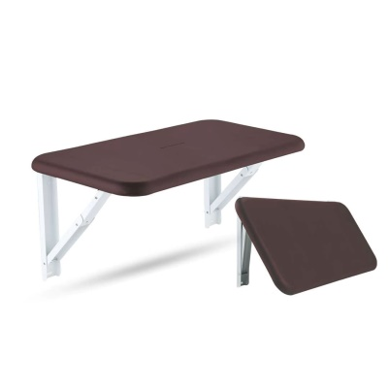

OUR BRAND Products :
BLOW MOULDED
CHAIRS & STOOLS
BLOW MOULDED
KIDS TABLE & STOOL
BLOW MOULDED
TABLES
ACE STUDENT CHAIR
EEZE – CHAIR WITH ARM REST
EEZE – CHAIR
IRIS – HIGH BAR CHAIR
TEENY STOOLS
HALF MOON TABLE
FULL MOON TABLE
SMILEY TABLE
BUNNY STOOL (WITH STORAGE – 10L)
BARON 4-FEET ROUND – IN – HALF TABLE
HUGO 5-FEET RECTANGULAR TABLE
TIFFANY BAR TABLE
CHEERY – CAFÉ TABLE
WALL MOUNTED FOLDABLE TABLE

Slide 11

India Footprint
PLANT No. 1 : Plot No. 14, HSIDC Industrial Estate, Sector – 59, Faridabad Haryana (INDIA).
PLANT No. 2 : Plot No. 25. PRAGATI VIHAR Industrial Estate, Sector – 59, Faridabad Haryana (INDIA).
PLANT No. 3 : Plot No. 30. PRAGATI VIHAR Industrial Estate, Sector – 59, Faridabad Haryana (INDIA).
PLANT 4 ( UPCOMING): Deeghot – Palwal, Haryana (INDIA), Plot Size : 6 Acres (Covered Area : 1 Lakhs Sq. Feet)
In Future All Manufacturing will be Integrated Here And Other Existing Plants Will Become Product, Tool Development & Marketing Centers

Slide 12


Magnum- Plant 1 Location (Faridabad, Haryana)

Slide 13



Magnum- Plant 2 & 3 Location (Faridabad, Haryana)
Plant – 3
Plant - 2
-Distance from Plant – 1 is 5 min

Slide 14

Magnum- Upcoming Manufacturing Plant 4
Deeghot – Palwal, Haryana (INDIA), Plot Size : 6 Acres (Covered Area : 1 Lakhs Sq. Feet).

Slide 15
03
03
In-House Tool Design & Tool Making

Slide 16
LIST OF MACHINES
S. NO. | MACHINE TYPE | CAPACITY | MAKE
1 | LATHE MACHINE | 6 FEET | GD
2 | LATHE MACHINE16 | 4 FEET | GD
3 | UNIVERSAL MILLING MACHINE | 2" INCH | PRECICUT
4 | UNIVERSAL MILLING MACHINE | 2" INCH | PRECICUT
5 | DRILLING | 1/2" INCH | ITCO
6 | VERTICAL MACHINING CENTRE ( VMC ) | VM700 | TAL.TATA
7 | SURFACE GRINDER | 9X14" | MACHINO
8 | SURFACE GRINDER | 9X18" | GURU ARJUN
9 | SURFACE GRINDER | 9X20" | GURU ARJUN
10 | SURFACE GRINDER (AUTOMATIC) | 10X32" | KASTRUP-DANMARK
11 | EDM (SPARK EROSION) | 520X30 | ELECTRONICA PSR SERIES
12 | CNC WIRECUT | 600X1050 | PHILIPS
13 | DRILL EDM | 600X400 | PHILIPS
14 | EDM | 850X590X370 | PHILIPS
15 | VERTICAL MACHINING CENTRE ( VMC ) * 2 NOS | VF2 | HAAS
16 | EDM (PZE 400) | 980x570x400 | PHILIPS
17 | CRYSTA APEX V574 | 500 x 700 x 400 | MITUTOYO

Slide 17






LIST OF MACHINES
HAAS VMC : VF2
PHILIPS EDM : PZE 400
VMC : VM 700
PRECICUT VERTICAL MILLING MACHINE : 2”
PHILIPS WIRECUT
PHILIPS EDM DRIL

Slide 18

UPGRADATION ACTIVITY
MITUTOYO CRYSTA APEX V574
COMMISIONED IN JULY 2024

Slide 19
TOOL DESIGN CAPABILITIES
2 PLATE MOULD
3 PLATE MOULD
HOT RUNNER MOULD
UNSCREWING MOULD
MOULDS WITH MULTIPLE LIFTERS & SIDE CORES

Slide 20






MOULD MANUFACTURING CAPABILITIES
2-PLATE MOULD
3-PLATE MOULD
HOT RUNNER MOULD
MULTIPLE INSERT MOULDING MOULDS
BLOW MOULDS FROM 1 LITRE TO 200 LITRES
MOULDS SUITABLE FOR PROCESSING HIGH PERFORMANCE MATERIAL LIKE PEEK,PPS ETC.
UNSCREWING MOULD
MOULDS WITH MULTIPLE LIFTERS AND SIDE CORES

Slide 21










In-House Tooling Design and Manufacturing

Slide 22
04
04
Customers & Honors

Slide 23























Main Customers : Magnum India
Brands directly served
Brands indirectly served
Technology + Quality + Fulfillment + Cost Multi-dimensional partnership with customers

Slide 24







Customer Awards & Honors
Recognition from JTEKT
for Indigenization
2023-24
Recognition from IFB
for Best Supplier
2022-23
Recognition from IFB
for Best Supplier In All Aspects
2022-2023
Recognition from JTEKT for Quality
2014
Recognition from JTEKT
for Delivery
2018-19
Recognition from JTEKT
for Indigenization
2017-18
Recognition from SONA
for Cost Competence

Slide 25

Milestones achieved
Partner Performance Award received from JTEKT India Group for “Support in Localisation” in FY 2023-24.
2 Nos High Precision 2 Microns Accuracy HASS VMC added in tool room.
ZNC High Precision EDM Machine Added in Tool Room.
MITUTOYO CRYSTA APEX V574 Commissioned in July 2024
Vision Measuring Machine Hexagon make Accuracy 2 Microns Added to achieve more accuracy in part dimension inspection.
100% Supplier Performance Rating for JTEKT for Period Apr’23 – Mar’24.
Upcoming Manufacturing Unit in 6 Acres area in Palwal Near KMP Circle.

Slide 26

Thanks for your time
We appreciate your business

